Slide 1
Word Processing
CSC 201: Computer Applications

Slide 2

Getting familiar with MS Word
It is a non-free text processing software package
Used mainly for text editing

Slide 3
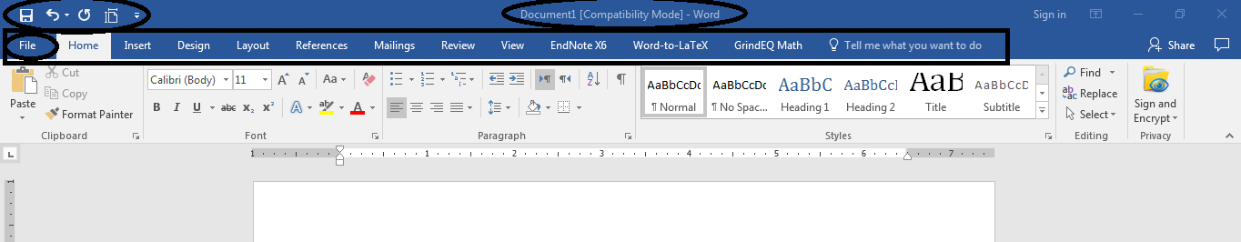
Graphical User Interface
Ribbon
Quick Access toolbar
Title Bar
Title Bar

Slide 4
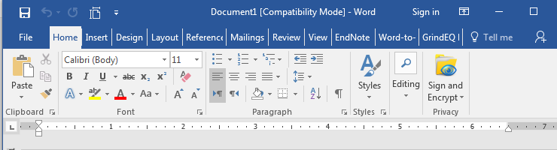
Ribbon
Tabs
Buttons
Font Group
Dialogue Box Launcher

Slide 5
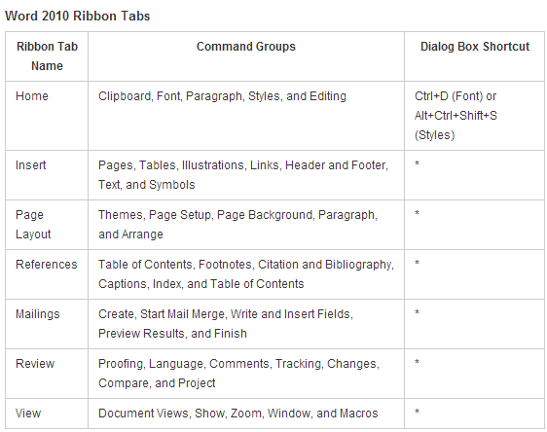
Ribbon Tabs

Slide 6
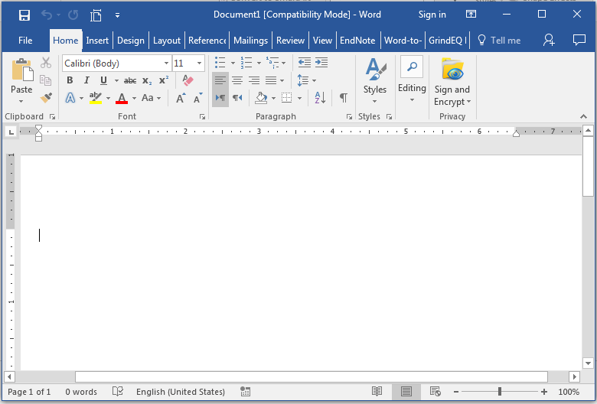
Text Area
Vertical Scroll Bar
Horizontal Scroll Bar
Zoom Bar

Slide 7
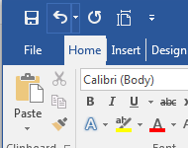
Quick Access Toolbar
Next to the Microsoft Word Button.
Provides you with access to commands you frequently use.
To add commands to your Quick Access Toolbar, press the arrow and check which commands you want to add.

Slide 8
Undo & Redo
You can quickly reverse most commands you execute by using Undo. If you then change your mind again, and want to reapply a command, you can use Redo.
Undo
Redo
Example:
Click the Undo button on the Quick Access menu. The typing disappears.
Click the Redo button on the Quick Access menu. The typing reappears.

Slide 9
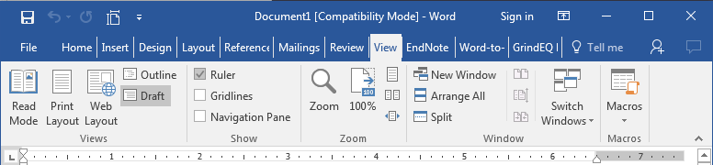
View
View
Draft
Draft View
Draft view is the most frequently used view. You use Draft view to quickly edit your document.
Web Layout
Web Layout view enables you to see your document as it would appear in a browser such as Internet Explorer.
Print Layout
The Print Layout view shows the document as it will look when it is printed.
Reading Layout
Reading Layout view formats your screen to make reading your document more comfortable.
Outline View
Outline view displays the document in outline form. You can display headings without the text. If you move a heading, the accompanying text moves with it.

Slide 10
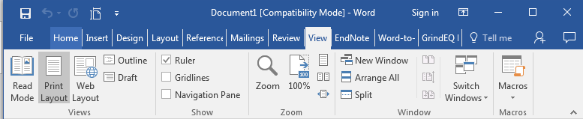
Ruler
The Ruler is found below the Ribbon.
Tool for setting Tab Stops
Indent Markers
If your ruler is not visible:
Click the View Tab.
Click the check box next to Ruler in the Show/Hide group. The ruler appears below the Ribbon
1
2

Slide 11
Creating a simple Document
Open MS Word 2016.
Click the File Tab.
Click New.
Choose a blank document, or choose from a template.

Slide 12

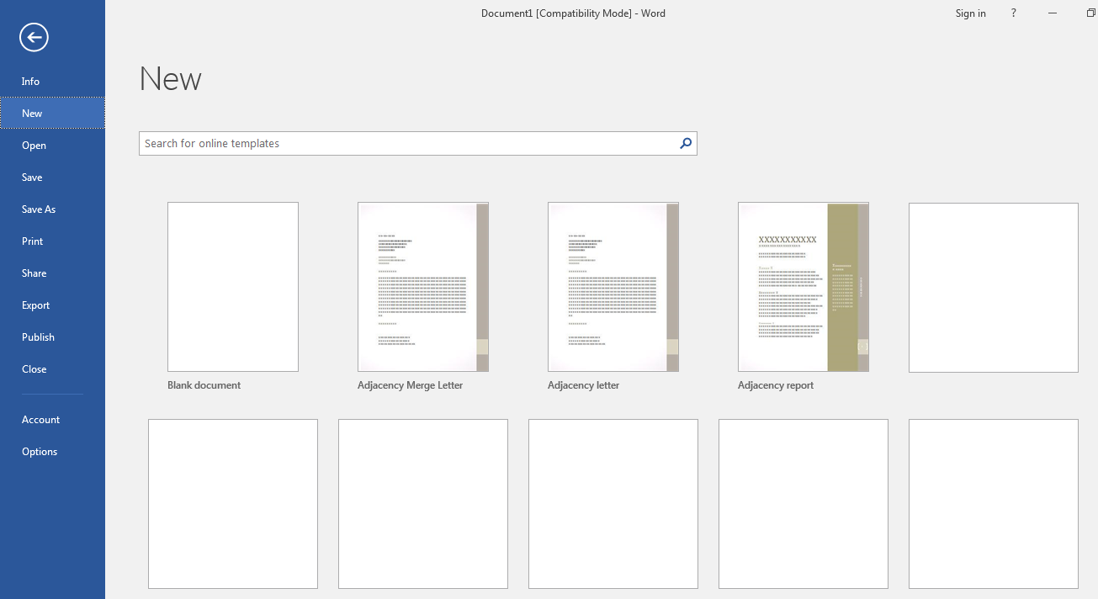
2
3
4

Slide 13
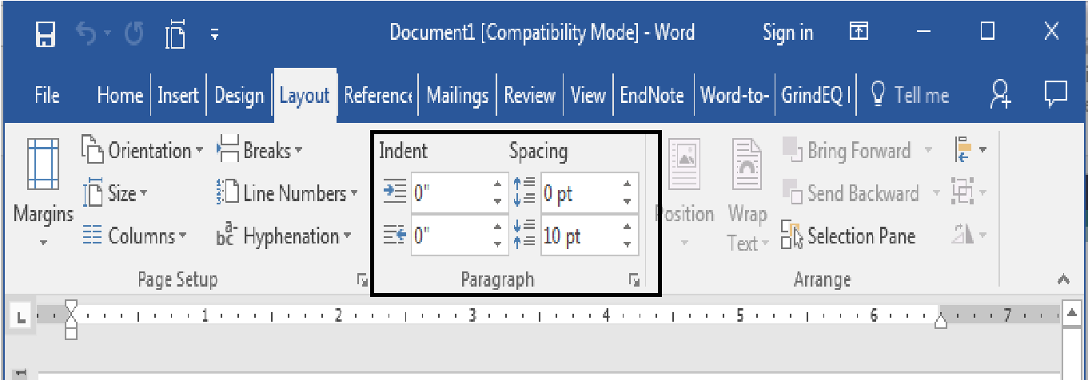
Formatting a Paragraph
Place your cursor anywhere in the second paragraph of the sample text.
Choose the Page Layout tab. The default spacing appears in the Spacing Before field.
Click the up arrow next to the Spacing Before field to increase the space before the paragraph.
Click the up arrow next to the Spacing After field to increase the amount of space after the paragraph.

Slide 14
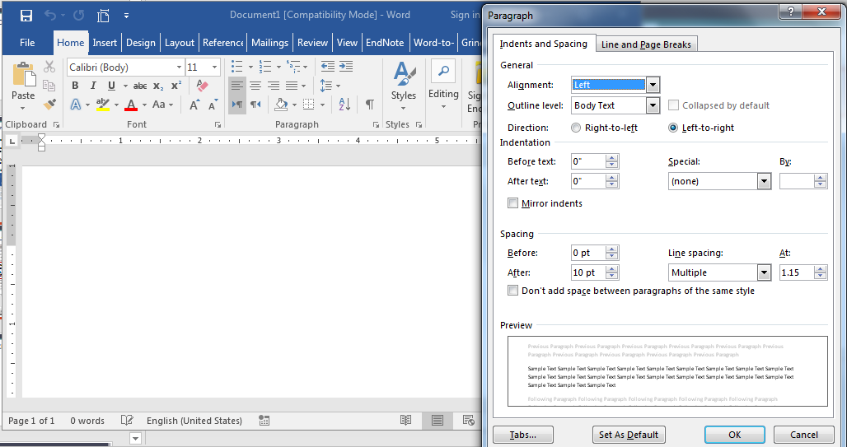
Line Spacing and Indentation
Set the alignment of the text to Left, Right, Centered, or Justified
Click this button to open the Paragraph Dialog Box
Special Indentation for the first line of the paragraph
Set the spacing between two lines of the same paragraph (i.e. 1.15 lines)

Slide 15
Choosing a Style Set
Choose the Home tab.
Click Change Styles in the Styles group. A menu appears.
Click Style Set. A menu appears. You can choose from any of the styles listed on the menu.
Click Simple (or any other Style Set). Word 2016 reformats all of the paragraphs into the Simple style.

Slide 16
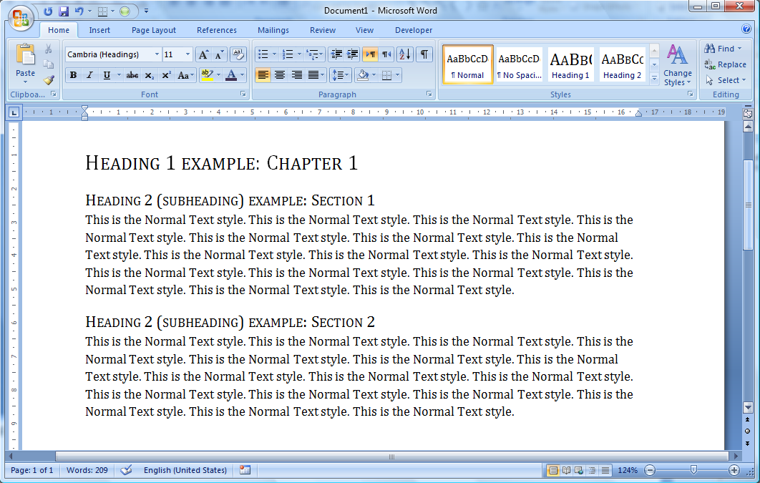
Applying Styles

Slide 17
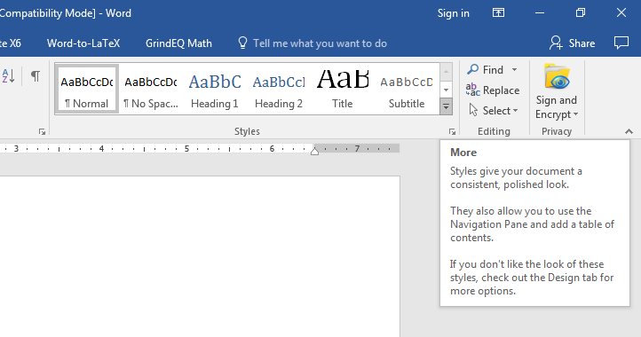
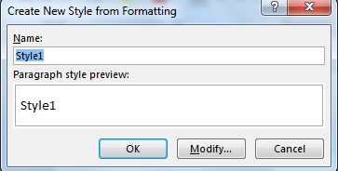
Creating a new style
Click on Modify for further options

Slide 18
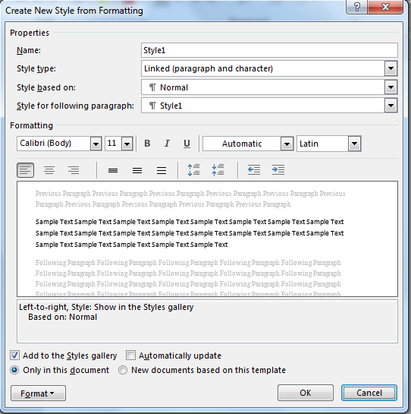
Choose a style name
Adjust style format
Adjust Paragraph formatting and other options

Slide 19
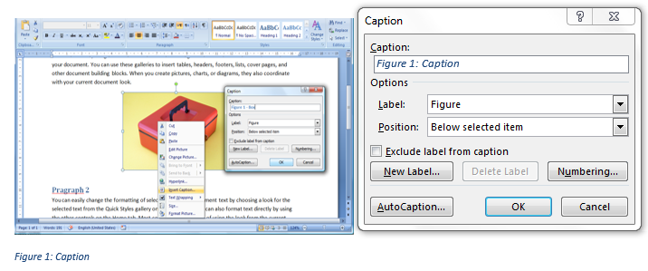
Inserting a picture Caption
2- Add a small description next to the caption
3- Click OK
1- Right Click on a picture, and select Insert Caption

Slide 20
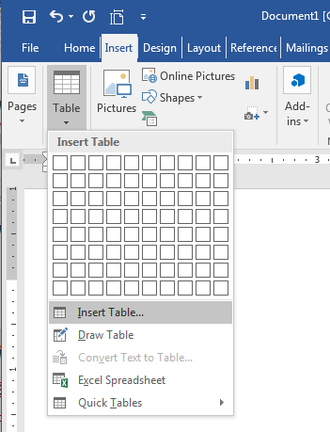
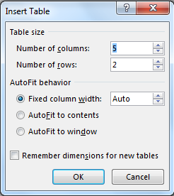
Creating a table
1- Choose Insert, Table
3- Choose the number of rows and columns
4- Click OK
2- Click Insert Table

Slide 21
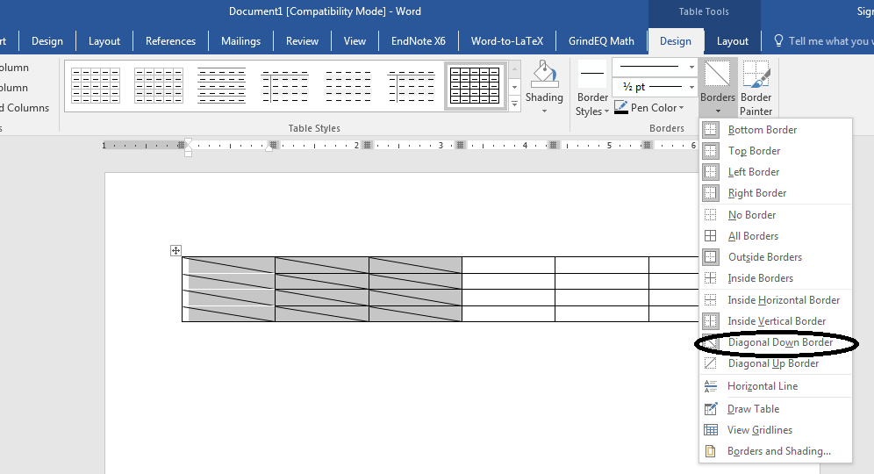
Modifying table borders
2- Select Design, Borders
1- Select the part of the table that you want to modify
3- Add or Remove the borders of the table

Slide 22
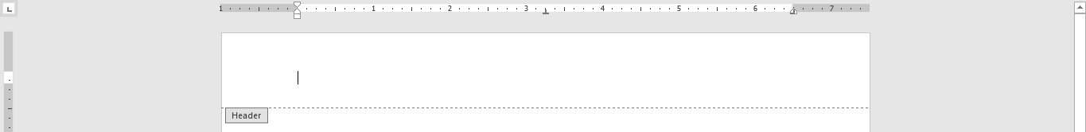
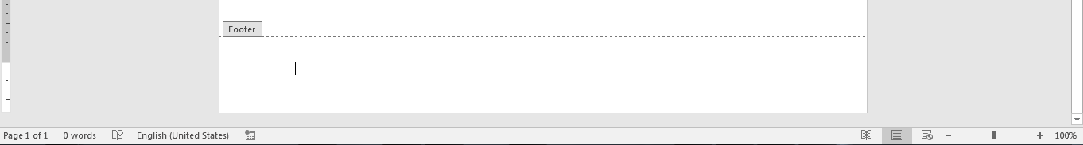
Header and Footer
Double click on the Top of a page in the Print Layout view to add a page Header. (The header is usually common to all the pages in the same section)
Double click on the Bottom of a page in the Print Layout view to add a page Footer. (The footer is usually common to all the pages in the same section)

Slide 23
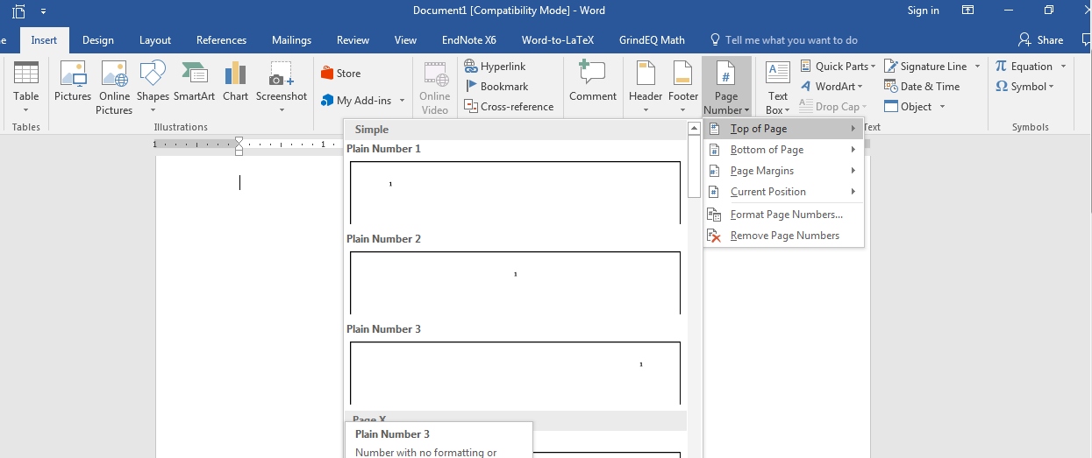
Inserting Page Numbers
1- Select Insert, Page Number
2- Choose the number format that you want

Slide 24
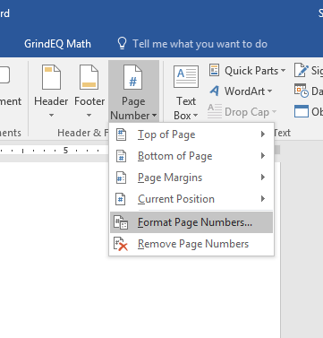
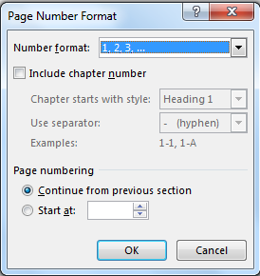
Formatting Page Numbers
1- Select Insert, Page Number
3- Choose the desired Number Format
4- Choose the first number in page numbering
2- Click on Format Page Numbers

Slide 25
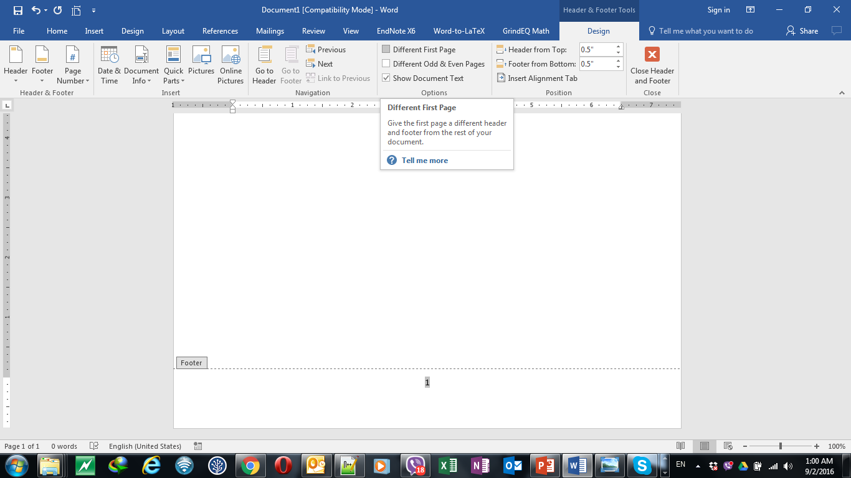
Removing page numbering from the first page
2- Tick the box next to Different First Page
3- Now you are able to modify the Footer and the Header of the first page of the section separately
1- Double click on the page number in the header or in the footer

Slide 26
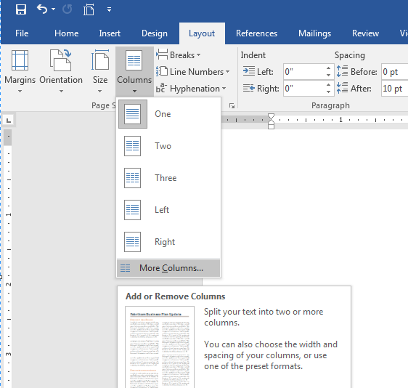
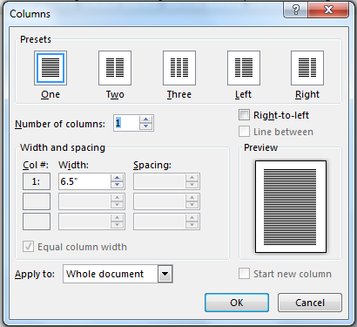
Columns
3- Choose the needed format
1- Select Page Layout, Columns
4- Choose the number of columns
2- Click on More Columns

Slide 27
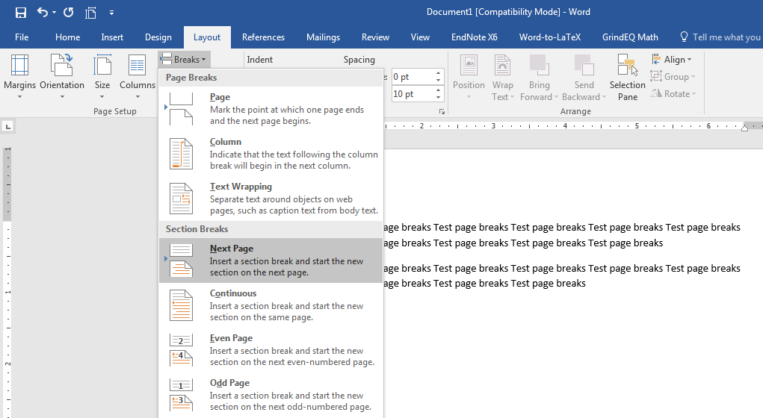
Section Breaks
•Use to divide one document into multiple parts, each one being independent from the others.
•This will allow:
Different Page Layout (Portrait/Landscape).
Different Page Numbering Scheme.
Different Page Headers/Footers.
1- Select Page Layout, Breaks
Note: A Page Break forces the following text to start on a new page, but the text remains in the same section
2- Select the desired Section Break

Slide 28
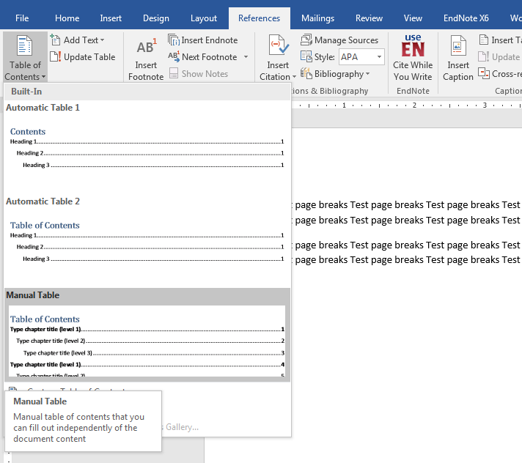
Inserting a Table of Contents
1- Select References, Table of Contents
Important Note!:
The table of contents will not work if you don’t use appropriate styles (i.e.: Heading1, Heading 2, and Heading 3…)
2- Select the desired format
Or choose Insert Table of Contents for advanced options

Slide 29
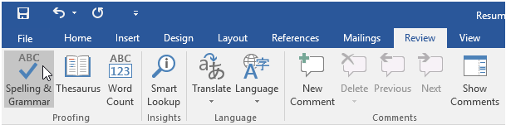
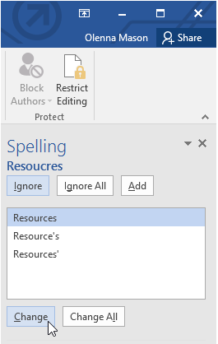
Document Review
The Spelling and Grammar pane will appear on the right. For each error in your document, Word will try to offer one or more suggestions. You can select a suggestion and click Change to correct the error.

Slide 30
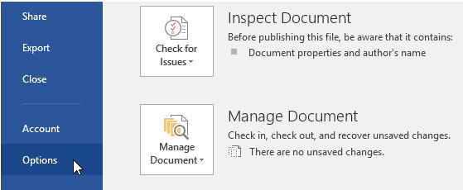
Document Review
To change the automatic spelling and grammar check settings:
Click the File tab to access Backstage view, then click Options.
A dialog box will appear. On the left side of the dialog box, select Proofing. From here, you have several options to choose from. For example, if you don't want Word to mark spelling errors, grammar errors, or frequently confused words automatically, simply uncheck the desired option.

Slide 31
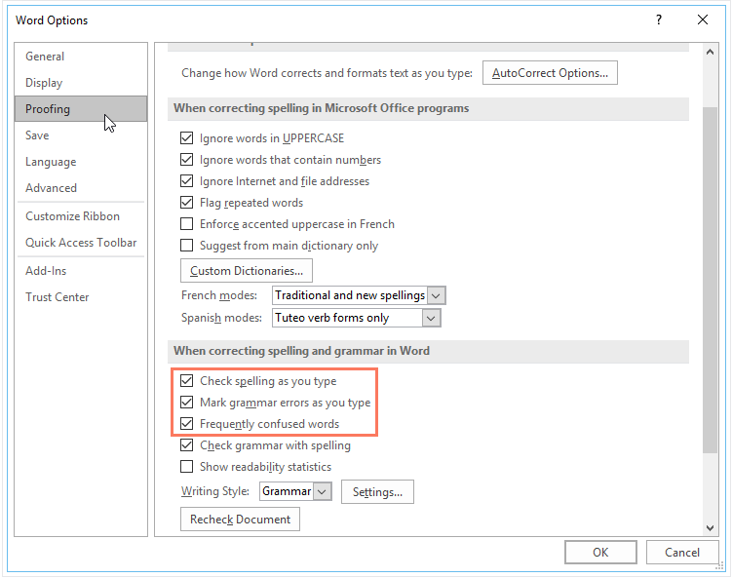
Document Review

Slide 32
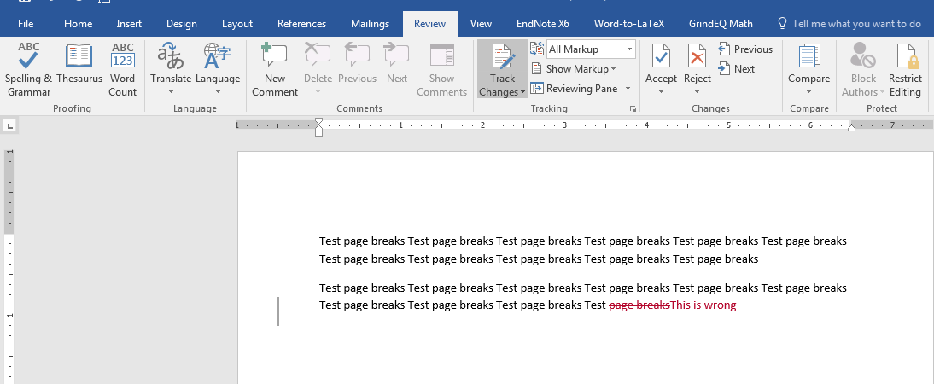
Tracking Changes
Track Changes is a way for Microsoft Word to keep track of the changes you make to a document. You can then choose to accept or reject those changes. (Useful when many people working on the same document)
1- Select Review, Track Changes
2- Text additions are tracked
3- Text deletions are also tracked

Slide 33
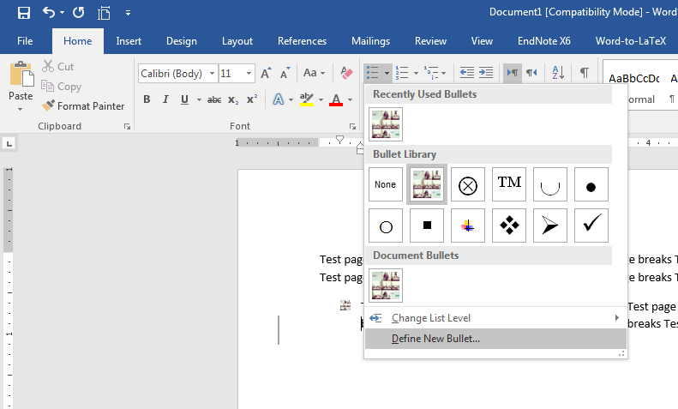
Personal Bullet Design
1- Select Home, Bullets
2- Click on Define New Bullet

Slide 34
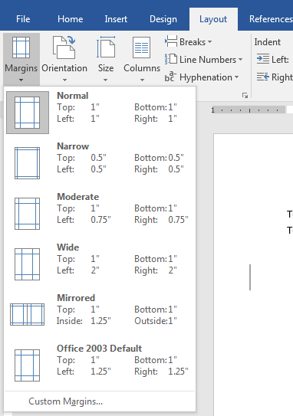
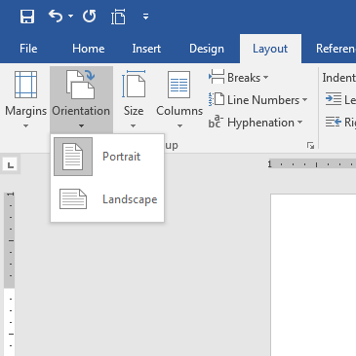
Changing Margins and Orientation
1- Select Page Layout, Margins
2- Choose the desired margins
You can also change the orientation from portrait to landscape
You can also set each margin separately by using Custom Margins

Slide 35
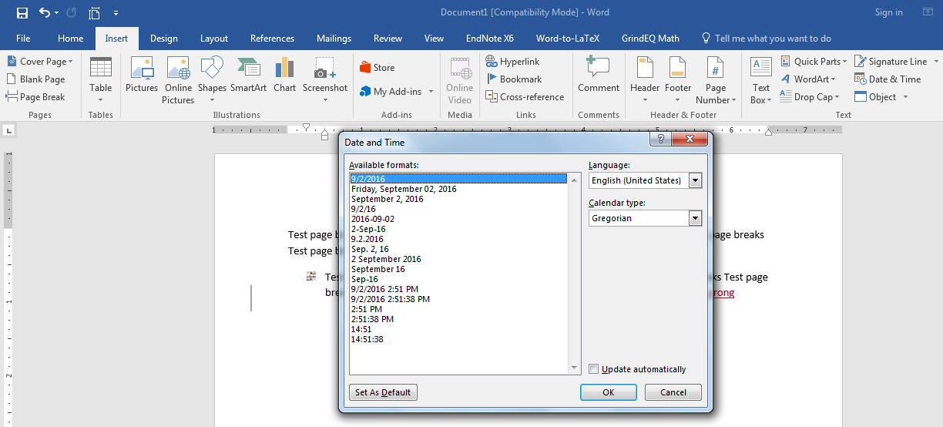
Automatic Updates
1- Select Insert, Date & Time
2- Choose the desired format, tick Update automatically, and then press OK

Slide 36
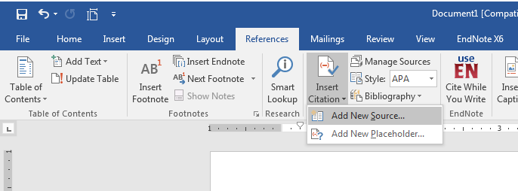
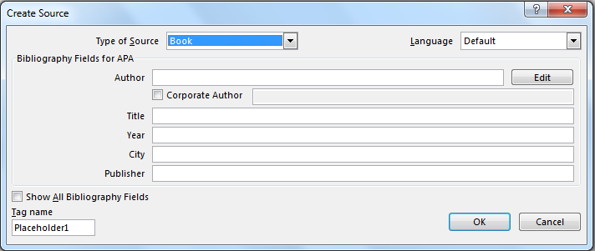
Citations and Bibliography

Slide 37
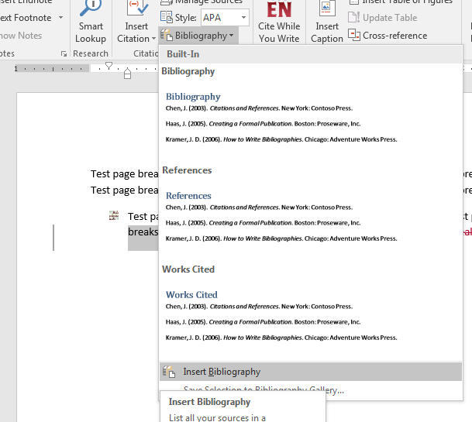
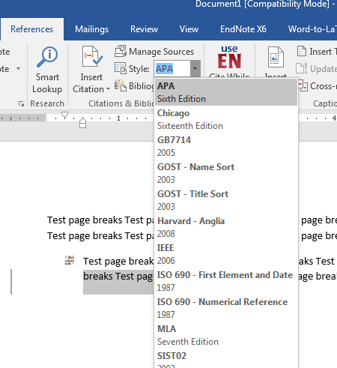
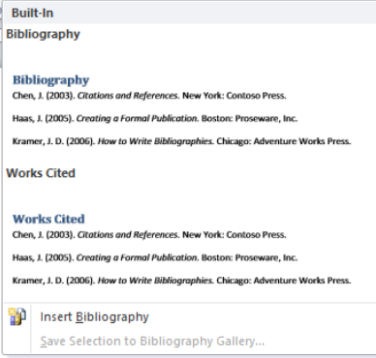
Citations and Bibliography

Slide 38
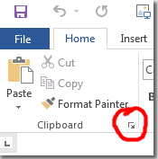
The Clipboard Panel
You can open the Clipboard panel by clicking on its launcher in the Clipboard group on the Home tab.
When you do, you will see the current contents of your clipboard (i.e. the last thing you copied). Whenever you copy some new selection of text or an image, it will be added to the top of the list. It’s not just items you copy in your Office programs that get copied; text and images from a web page, for example, will appear in the list if you copy them.

Slide 39
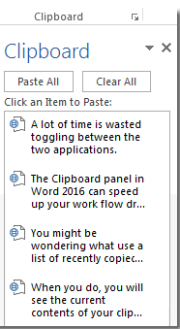
The Clipboard Panel
You might be wondering what use a list of recently copied items is. Well, the magic happens when you click on an item in the list. When you do, it gets pasted into your document where your cursor is positioned.

Slide 40
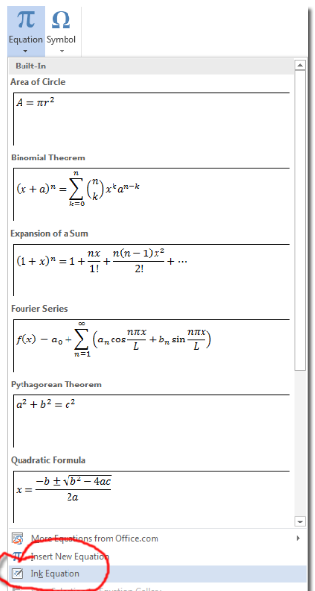
Equation Inking
To add your own ink equation, go to the Insert tab and click on the down arrow at the bottom of the Equation command. Select Ink Equation.

Slide 41
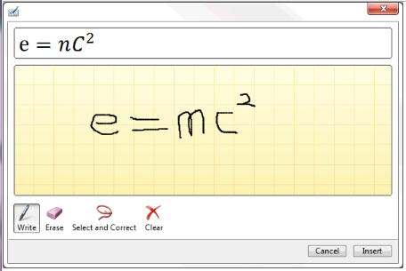
Equation Inking
In the writing area that opens up, draw out your equation with your mouse. Alternatively, if you have a touch device, you can use your finger or a touch stylus to write math equations by hand, and Word 2016 will convert it to text.

Slide 42

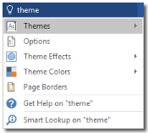
Tell Me Tool
If you need to perform a particular task, but you don’t know how to, you can type words or phrases related to your task into the Tell Me tool. This new tool can be found in the ribbon, whichever tab you are on.
When you start typing, Word suggests commands that are related to your keyword. For example, when you type “theme”, Word will suggest the following:

Slide 43
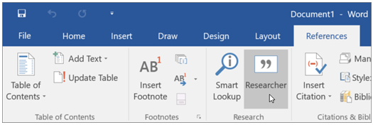
Quick Search
When you want to research and write about a topic for your college paper or school project, use Researcher in Word 2016 to give you a jumpstart in writing your paper.

Slide 44
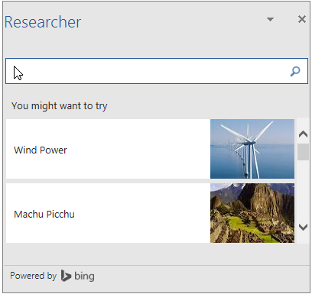
Quick Search
With Researcher you can search for any topic on the web, refer to research articles, insert images and content from the web into your document - all of it without leaving the Word document.

Slide 45
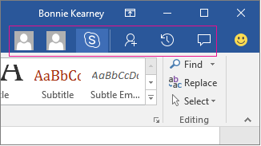
Enhanced Collaboration
When you open a shared document on OneDrive, at a glance you can see who is working within the document and where. You can chat with collaborators in real time by using Skype for Business, and can view document activity, all from the top-right corner on the ribbon.

Slide 46

Enhanced Collaboration
Choose a thumbnail picture of a person to begin an IM conversation by using Skype for Business or open their contact card information. Choose the Skype for Business button to start a group chat with everybody working in the document.
The new Activity pane lets you see the complete list of changes made so far, and gives you access to the earlier versions. Choose Activity on the ribbon to see the Activity pane.
Now with one click of on the ribbon you can make or view comments in your document. With enhanced collaboration, it's easier to reply to or resolve comments and mark them as complete.

Slide 47

Changing Theme
The default Office 2016 theme is called Colorful, and looks like this:

Slide 48

Changing Theme
You can change the default theme for Word 2016 (and all the other Office 2016 applications work like this) by clicking File > Account, and then change the Office Theme dropdown selector.:

